Slide 1
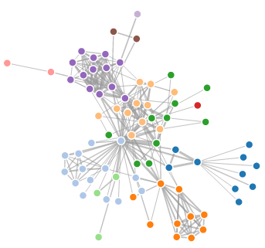
Open Source Business Intelligence
Jeff Gunderson
xTuple Erp

Slide 2


Open Source Background
xTuple
World’s #1 Open Source ERP
Integrated Business Intelligence
www.xtuple.org
Erp BI So
Open Source BI for Sales and Financials using Pentaho.
www.erpbisolutions.com (examples in demo are available)
Notes:
xTuple ERP is the Worlds’ #1 open source ERP. We a building business intelligence into the product using pentaho technologies.
erpBI Solutions is an open source project that provides a solution for sales and financials. Its a good example of how to build solutions with pentaho and most of the demos in this presenation are from erpBI. You can download and try it. It’s all pre-installed, self contained.

Slide 3

Open Source Benefits
Freedom
Less licensing restictions, free to evaluate, “free” to use, free to change.
Innovative
Evolves quickly in response to community
No Vendor Lockin
Community support, Commercial support, Self Service support
Reliable
Especially for large communities.
Notes:
Copyright law protects the author of a work by requiring that yyou muyst have the author’s permission to copy, disttribute or publish the work or derivations of the work.
What a software license does is define these permissions. For example to use this software you must have a signed agreement and the signed agreement has a useage fee and you may not redistribute it.
Open source software is software under a license that has few restrictions reguarding the source.
The success of opens source software comes from this freedom. The freedom from licensing restrictions, freedom from charges, freedom to evaluate and use, the freedom to make changes and the freedom to redistribute.
The other reason open source succeeds is that it is developed in a different manor. OS is develped by a community rather than a commercial organization and evolves to meet to needs of the community. This can produce very innovative, very reliable, very useful software.

Slide 4

But Do Your Homework
Support and Support Cost
Your organization or commercial edition or third party or just luck
License Restictions
Concern for redistribution and commercialization
Your organization’s restrictions.
Activity
Check releases, contributions, download charts
Large Community for Large Project
Check forums, members.

Slide 5



Key Players
ETL, OLAP analysis, metadata, data mining, reporting, dashboards
ETL, OLAP analysis, metadata, reporting
reporting, dashboards

Slide 6
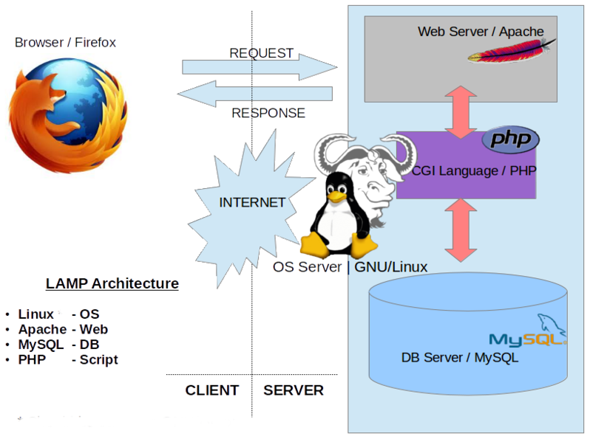
OSBI Architecture
Platform Neutral (Java)
Linux, Mac, Windows
Database Neutral
OS Databases, Proprietary Databases, Big Data
App Server Neutral
Well sorta – J2EE Compliant
Componentized & Standards Based

Slide 7
Reporting
Features
Designers & report servers.
Large variety of data sources.
Crosstabs, subreports, charts.
Web-base reports with controls.
Pentaho Reporting
JasperReports
Birt Reporting
Notes:
Pentaho Reporting based on JFreeReports. LGPL License. Reporting engine runs in J2EE containers.
JasperReports is under the LGPL license. Jasper Studio is now the designer – Eclipse based. JasperReports library run in J2EE containers.
Birt is under the Eclipse Public License. Designer is Eclipse based. Birt libraries run in J2EE containers.
Demo: samples/production reports/invoice statements.prpt.
Note: drag & drop
test from designer, when server from Web, parameters ar in a form at teh top of the page.

Slide 8
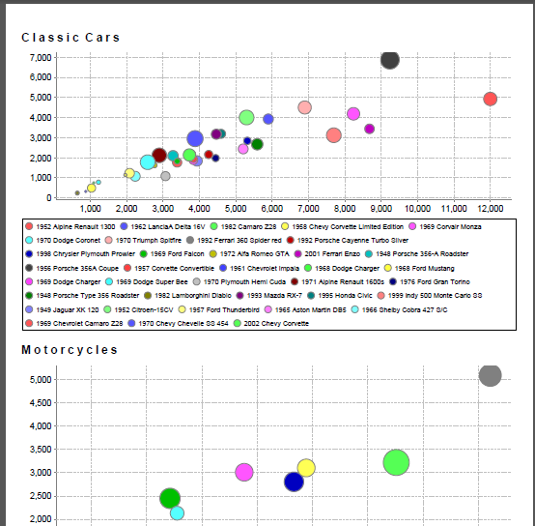
Report Example: Charts and Forms in Pentaho Reports

Slide 9
ETL
Features
Designers, servers for remote execution.
Large variety of data sources and data targets.
Large set of tools.
Pentaho Data Integration (Kettle)
JasperETL (Talend)
Notes:
Pentaho Data Integration based on Kettle ETL. LGPL License. Carte remote server to distribute ETL. ETL is interpreted.
JasperETL based on Talend. Apache license. ETL generates Java code.
Demo: data-integration/samples/data validation
Note: data validation,
wide range of tools
load.kjb
application of creating/loading data marts
note not just data tools but web services, email
open conformed dimensions

Slide 10
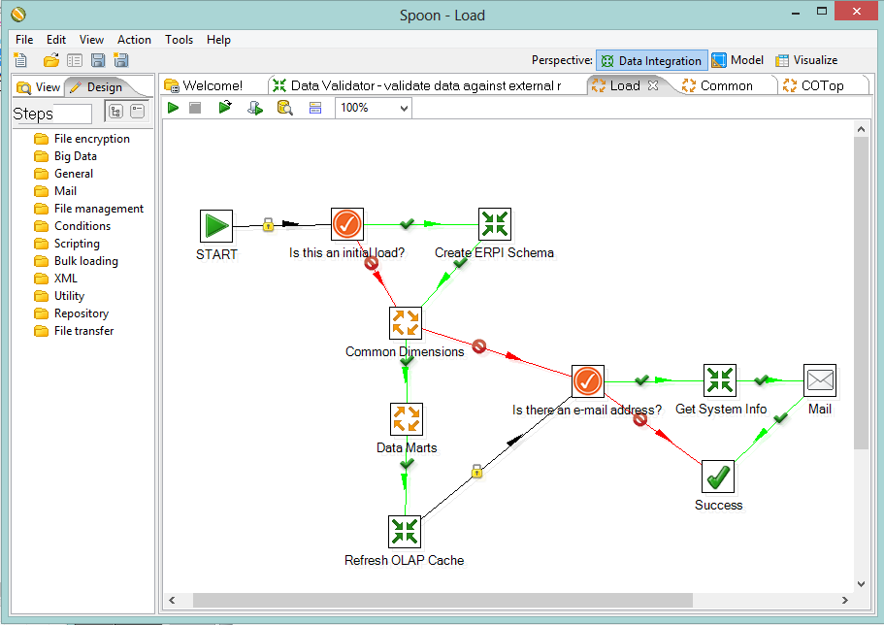
ETL Example: Loading Data Mart with Pentaho PDI in xTuple

Slide 11
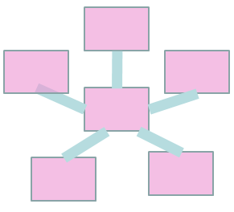
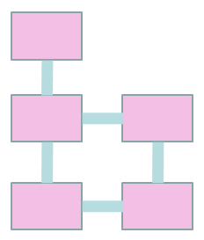
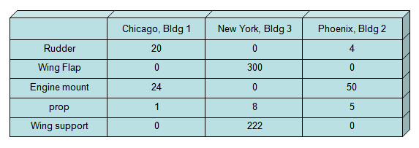
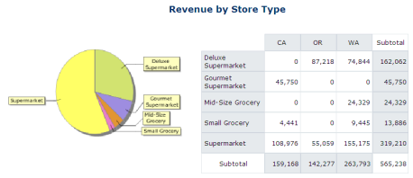
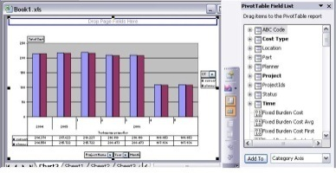

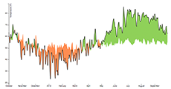
OLAP
Cube
schema
ETL
Procedures
Data Mart
Operational Data
OLAP Cubes
Dashboard Frameworks
Reports
Ad-hoc Tools
Chart Components

Slide 12

OLAP
Mondrian
Relational OLAP
In-memory cubes
Good MDX language coverage
XMLA support
Pentaho BI Server
Jaspersoft JasperReports Server
Or install in your app server.

Slide 13
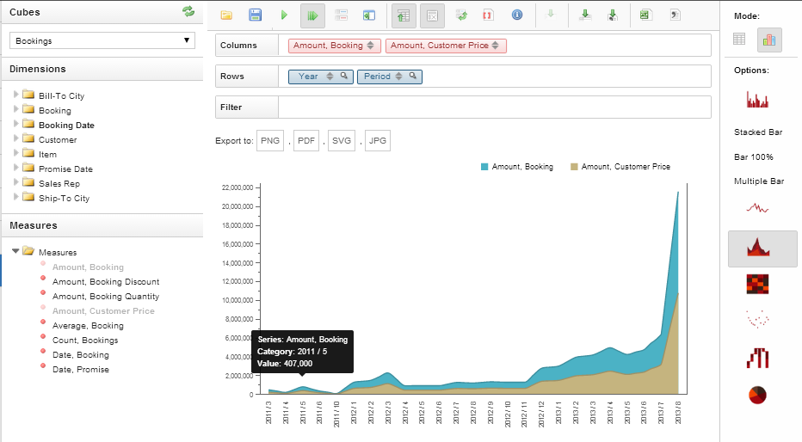
OLAP Example: Exploring cubes with Saiku in xTuple Analytics

Slide 14
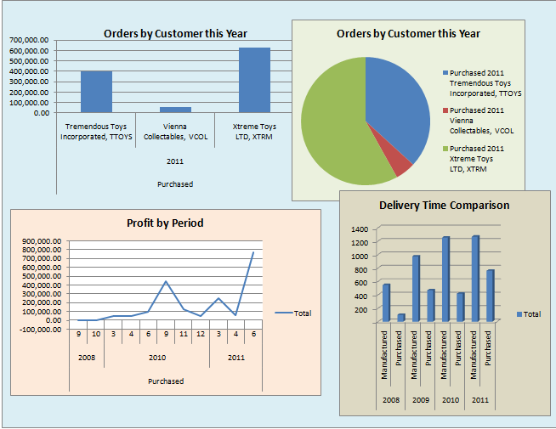
Visualizations
Ad-hoc tools
Data exploration (drag & drop)
No programming
Saiku - http://www.meteorite.bi/saiku
Dashboard Editor/Framework
SQL or MDX knowledge
Pentaho Ctools, Birt Reports
Chart Components
SQL/MDX, Javascript knowledge
D3, HTML5 components
Notes:
If you work on BI solutions you understand the value of good visualizations. In the open source world there’s very good technology but it going to take more work that proprietaty BI products. The proprietary products have more advanced develpment tools to help you develop dashboards and charts.
Note that open source projects like Jaspersoft and Pentaho have enterprise versions that provided more advanced developement tools.

Slide 15
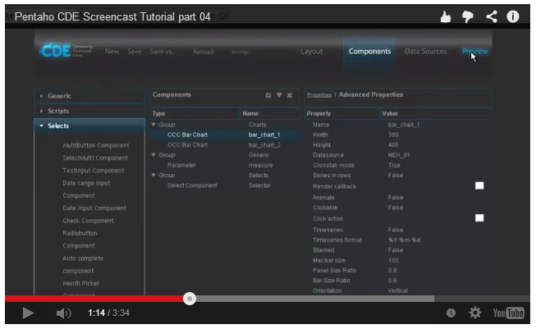
Ctools for Pentaho
Community Dashboard Editor
http://www.webdetails.pt/ctools/cde.html
Community Dashboard Framework
Javascript component framework
Notes:
The Community Dashboard Editor is a Web-based tool that helps you develop dashboards that work in the Community dashboard framework. You can define data sources, queries, charts and controls.
You can also define dashboards as Javascript components that run in the framework. This gives you more control over the presentation.
Demo
Financial charts show how well you doing for each of the financial kpis for year and period the trend.
You can drill down (dial) to other dashboards.
You cand use controls to add filters to queries.

Slide 16
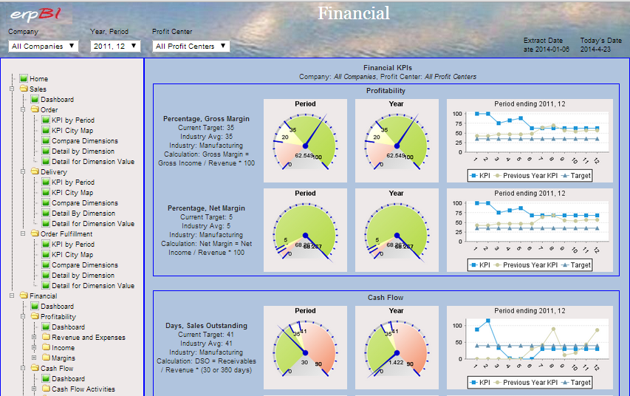
CDF Example: Financial Dashboard with Filter Controls

Slide 17
Chart Components
D3.js (Data-Driven Documents)
JavaScipt components using Scalable Vector Graphics
github.com/mbostock/d3/wiki/Gallery
Chart components based on D3
NVD3 - nvd3.org/
Rickshaw - code.shutterstock.com/rickshaw/
Dimple - dimplejs.org/
Notes:
D3.js components are very popular. It works with other browser technologies – Javascript, CSS, SVG, HTML5. It does not have visual limitations of otehr technolgie and it can be used make very interactive visualizations.
http://ramblings.mcpher.com/Home/excelquirks/gassites/d3nodefocus

Slide 18
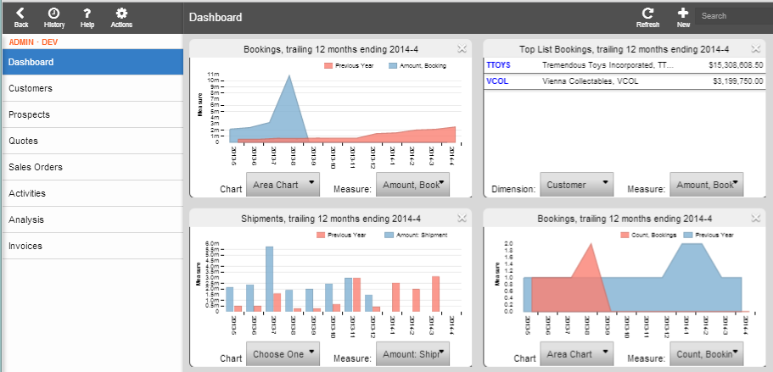
D3 Chart Example: Dashboard in xTuple

Slide 19
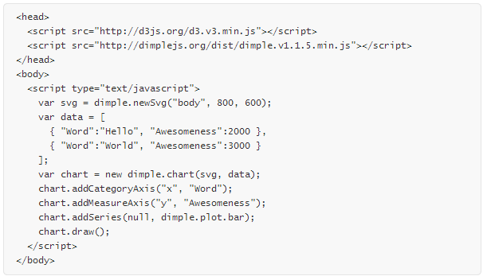
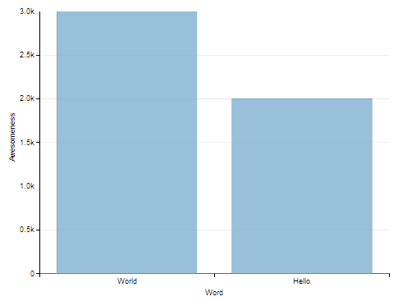
D3 Coding Example: Dimple Chart

Slide 20
Need Help?
Contact :
jgunderson@erpbisolutions.com
jeff@xtuple.com
Thank You!
Notes:
.

